Slide 1
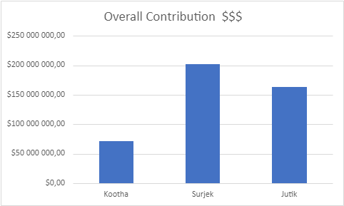
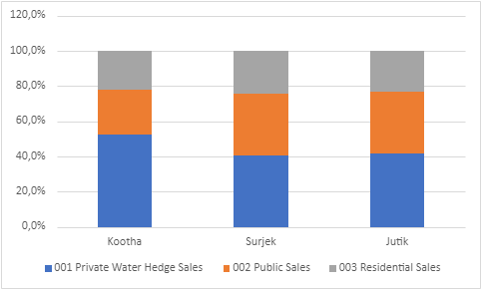
Segmentation of the revenues by unit, reveals that of the three (3) customer segments, Private water Hedge Sales (187M) are the most popular, followed by Public Sales ($147 M) and lastly Residential Sales ($102M).

Slide 2
Of the ($436 M )¹ in Revenue Sales over the July-2013 to June-2014 Period, Surjek provides close to 50% of Sales Volumes ($202 M), with Jutik ($ 163 M) and Kootha ($ 70M) providing the remaining.
Note: This refers to the Total Sales for all 3 Units (Kootha, Surjek and Jutik)

Slide 3
Targeted Expense Analysis reveals an interesting trend; Overall Costs sharply increase from December, with Chemical and Labour cost, contributing $ 165 (52%) towards the overall cost-base.

Slide 4
Further analysis singles-out Surjek_with 179 M (55%) worth of expenses, contrasted to a much lower spend from _Kootha ($51 M) and Jutik ($90M), largely due to lower Chemical and Labour Expenditure.

Slide 5
Drilling-down to the cost-element level, reveals an indicative relationship between water production and chemical expenditure with this being particularly pronounced for the Surjek_Unit which coincidentally has the highest rate of water production.

Slide 6
Concluding our analysis, Juitek_has the highest overall EBIT contributions ($73M), followed by _Surjek_($23 M) , and lastly Kootha ($ 20 M). However, from an EBIT Margin (%) perspective, Kootha has a higher margin than that of Surjek, indicative of a lower revenue-to-expense ratio.¹
Note:¹ We can clearly see for Surjek over the October, November and May Periods – expenses were far higher than revenues which contributed to this lower revenue-to-expense ratio.

